Slide 1
BRASIL ROADSHOW
Digital Edition 2020
Notes:
Agradecimiento AV
Buenos días a todos
Presentar a Galtaroca, radiografía

Slide 2
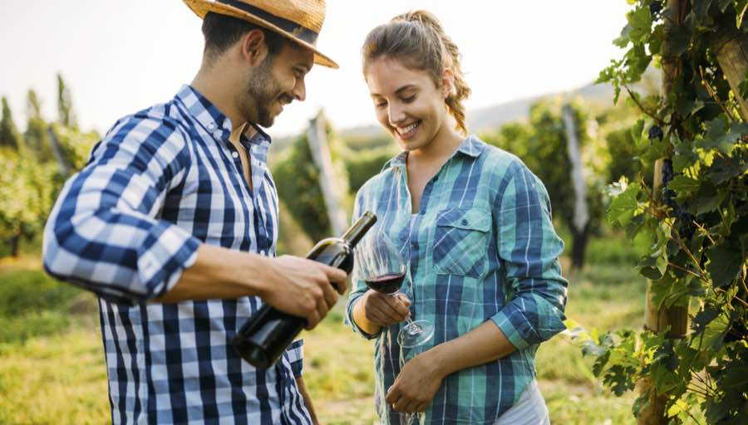
Objectives

Slide 3
Objectives
Educate local importers, distributors, retailers and HORECA players to better understand and appreciate Chilean wines;
Connect Chilean wineries with importers, distributors and retailers for potential business opportunity;
Generate consumer awareness of Chilean wines and wineries through press coverage, key opinion leaders and social media.
NEW BUSINESS OPPORTUNITIES
BRAND IMAGE
+

Slide 4
Cities
Wines of Chile Digital Road Show will engage trade members, journalists, key opinion leaders (KOLs) and digital influencers from the 5 largest wine consumption markets in Brazil:
São Paulo (and surrounding cities);
Rio de Janeiro
Belo Horizonte
Curitiba
Recife

Slide 5
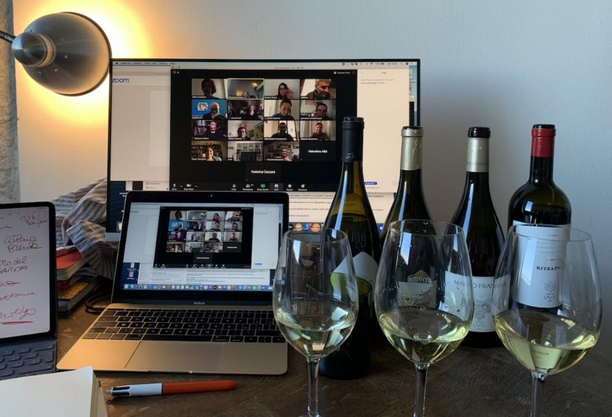
Activities

Slide 6
Format
PR AND DIGITAL CAMPAIGN
DIGITAL MASTERCLASS
ON THE ROAD DIGITAL FAIR
DIGITAL BUSINESS MEETINGS

Slide 7
PR and Digital Campaign
PR campaign format: 1 Press Release announcing Wines of Chile On The Road Digital Edition, which will be sent to the specialized press and key wine influencers to generate publications on the media of the participant wineries;
Digital campaign format: 4 social media posts promoting WoC On the Road Digital Edition, Chilean wines and Jessica Marinzecks’s Chile videos to social media followers;
Materials: promotional kits with wines and catalogue to be delivered to online tasting participants;
Duration: 6 weeks;
Target: over 300 journalists and digital influencers; over 1.500 social media followers on Instagram, Facebook.

Slide 8
Digital Masterclass to Expert KOLs
3 groups / 5 events / available to small wineries!
Wineries to participate: 12 wineries + 6 small wineries;
Wines: 1 label per winery / 6 labels per class
Target: 70 key opinion leaders (KOL) attendees, including wine educators, specialized journalists and digital wine influencers;
Duration: 2 groups for a 2-day masterclass + 1 group for a 1-day masterclass dedicated to smaller producers; 5 classes in total;
Moderator: Expert sommelier with influence among traders
Format: the host will lead the Master Class by presenting in-depth knowledge of Chilean wines to a public of specialists. Then he will present the wines and interact with wineries’ spokespersons.
Theme suggestions: the microclimates of Chile and the different wines they originate; 90+ Chilean wines.

Slide 9
WoC On the Road Digital Fair
Wineries to participate: 10-12 wineries;
Wines: 1 label per winery / 6 labels per presentation
Target: 100 trade members and life-style digital influencers
Duration: 2 groups for a 2-day presentation (4 presentations in total) / 40-50 participants each group / 1 hour per presentation;
Cities: 21 cities in Brazil
Format: the host will lead an introductory class, presenting Chile’s major wine regions and wines to a public of mostly trade members and selected life-style influencers. Then he will present the wines and interact with wineries’ spokespersons.
Theme suggestions: a journey through the major wine regions in Chile, their characteristics and the most important wine styles they produce;

Slide 10
Post Event Digital Business Meetings
Format: each trade member will receive a digital catalogue with information of participant wineries’ products and information for contact and will indicate the wineries that have interested them the most;
Target: 100 trade members, including importers, distributors, retailers and and HORECA;
Coverage: 20 cities in Brazil;
Extra: wineries will receive a list with the names and contacts of trade participants, for prospecting business opportunities;

Slide 11
Digital Resources
E-invite: we will send all invitations (RSVP) through digital platforms, including e-mail and Whatspp;
Landing page: to register, guests will be taken to a personalized landing page, with Wines of Chile’s and participant wineries’ brands, where it will be possible to watch an institutional video and leave all the relevant contact information to join the event;
Digital welcome kit: along with the wine box, participants will receive a QR Code, which will lead them to a digital welcome kit, containing information, images and other relevant resources for the event;
Welcome video presentation: the QR code will also lead to a video, in which Wines of Chile will be able to welcome participants to the event and offer introductory information;

Slide 12
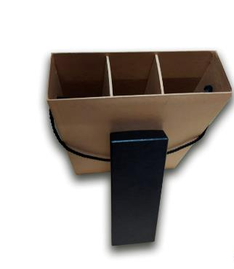
Customized wine kits
Wine box models, which will be customized with WoC’s colours, logo and a personalised design;
Boxes will come with a QR Code to access a welcome landing page, including video, images and informations;
*Boxes included in the budget are bigger, supporting 6 bottles each.

Slide 13
Schedule & Conditions
Kick off requirements: project approval with a minimum of 10 participant wineries, 50% payment at project launch;
Timeline
Week 0: arrival of wines in distribution center in Brazil;
Week 0-5: PR Campaign
Weeks 1-3: production, assembling and dispatching of promotional kits with wines for the virtual tastings;
Weeks 4-5: time for arrival of wines to participants;
Week 6: virtual events
Week 7-8: post event business meetings and report.

Slide 14
Budget will cover
RSVP (convocatoria)
Content creation
Storage and handling of wines
Logistic coordination
Designer for digital materials
Packages for wine kits
Wine expert’s fee to conduct Masterclasses
Video edition
Social media advertisement
* Budget does not include wines and logistics from Chile to São Paulo

Slide 15
Wineries Participation
PARTICIPACION | ETAPAS |  |  |  | Precio (USD) | WOC Price (USD)
 | PR & Digital Campaing | Masterclass | Digital Fair | Business Meetings
Standard | Incluido | Incluido | Incluido | Incluido | 1300 | 1000
Light* | Incluido | Incluido | NO Incluido | Incluido | 390 | 300
* Only available to small wineries.

Slide 16
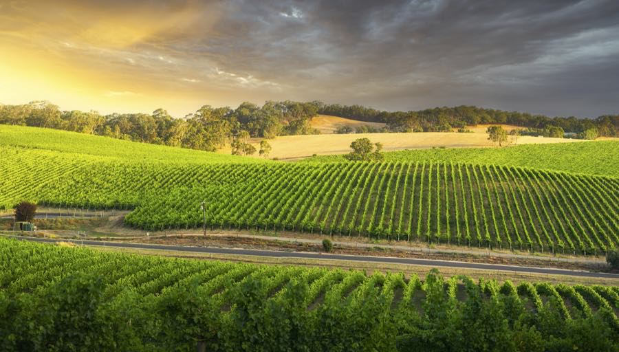
KPI’s

Slide 17
KPI’s
PR and Digital Campaign
Social media impact 1,5k social media followers
Journalists and KOLs reached 300 from Winext’s contact base
Media impact Publications based on relevant media vehicles
Master Class to KOLs
Number of Attendees 70
Profile Specialized press, key influencers
Wines served 18 skus, total 810 bottles tasted
Media impact Articles and contents published by KOL
On the Road Digital Fair
Number of attendees 100 trade trade members and lifestyle digital influencers
Cities impacted 5 of the most important tier 1 and 2 markets in Brazil
Wines served 12 skus, total 1,260 bottles tasted
Media impact Publications by participant digital influencers
Business Meetings
Number of qualified leads 100 qualified leads
Leads profile Buyers from supermarkets, retailers and HORECA
Shared Data Base of professionals Name, company, position, email

Slide 18
BRASIL ROADSHOW
Digital Edition 2020
Notes:
Agradecimiento AV
Buenos días a todos
Presentar a Galtaroca, radiografía

